Slide 1
Theory of Automata Variations of Turing machine
Dr. Sabina Akhtar

Slide 2
Revision

Slide 3
TMs with storage
Generic description
Will work for both a=0 and a=1
E.g., TM for 01* + 10*
Current Storage symbol
Tape symbol
Next state
Current state
New Storage symbol
q
Transition function δ:
δ([q₀,B],a) = ([q₁,a], a, R)
δ([q₁,a],a) = ([q₁,a], a, R)
δ([q₁,a],B) = ([q₂,B], B, R)
storage
Tape head
B
B
0
1
1
1
1
1
B
B
…
Are the standard TMs
equivalent to TMs with storage?
Yes
[q,a]:
where q is current state,
a is the symbol in storage

Slide 4
Class Activity
Design Turing machine with storage for
L = {w#w | w is any string containing 0’s and 1’s}

Slide 5
Multi-track Turing Machines
TM with multiple tracks, but just one unified tape head
control
One tape head to read k symbols from the k tracks at one step.
Track 1
…
…
…
…
Track 2
…
…
Track k
…
…

Slide 6
Multi-Track TMs
TM with multiple “tracks” but just one head
E.g., TM for {wcw | w∈ {0,1}* } but w/o modifying original input string
BEFORE
control
AFTER
control
Tape head
Tape head
…
B
B
0
1
0
c
0
1
0
B
…
Track 1
…
B
B
0
1
0
c
0
1
0
B
…
Track 1
…
B
B
B
B
B
B
B
B
B
B
…
Track 2
…
B
B
X
X
X
c
Y
Y
Y
B
…
Track 2
Second track mainly used as a scratch space for marking

Slide 7
Multi-tape Turing Machines
TM with multiple tapes, each tape with a separate head
Each head can move independently of the others
control
k separate heads
Tape 1
…
…
…
…
Tape 2
…
Tape k
…
…

Slide 8
On how a Multi-tape TM would operate
Initially:
The input is in tape #1 surrounded by blanks
All other tapes contain only blanks
The tape head for tape #1 points to the 1st symbol of the input
The heads for all other tapes point at an arbitrary cell (doesn’t matter because they are all blanks anyway)
A move:
Is a function (current state, the symbols pointed by all the heads)
After each move, each tape head can move independently (left or right) of one another

Slide 9
Non-deterministic TMs
Non-deterministic TMs ≡ Deterministic TMs
A TM can have non-deterministic moves:
δ(q,X) = { (q₁,Y₁,D₁), (q₂,Y₂,D₂), … }
Simulation using a multitape deterministic TM:
Control
Input tape
ID₁
*
ID₂
*
ID₃
*
ID₄
*
Marker tape
Scratch tape

Slide 10
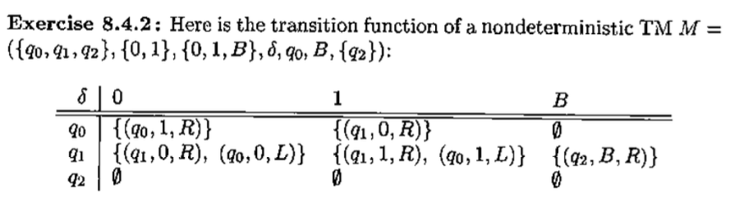
Example
Show the ID’s reachable from the initial ID if the input is
01
Notes:
[q0]01 |- 1[q0]1 |- 10[q1] |- 10B[q2]

Slide 11
Class Activity
Show the ID’s reachable from the initial ID if the input is
011

Slide 13
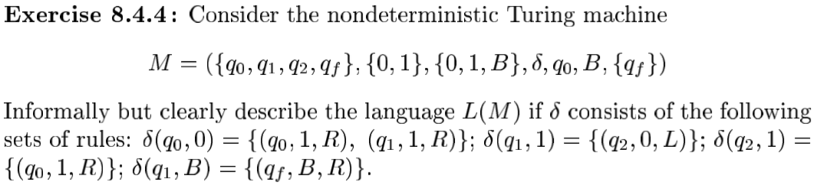
Class Activity

Slide 14
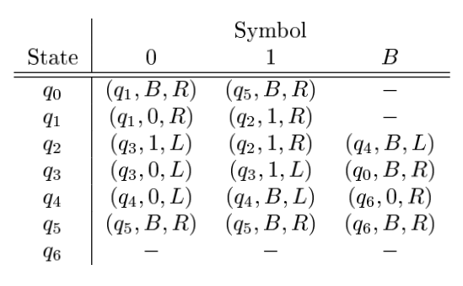
Class Activity
Simulate the w = 0001000 & w= 0010 using the following Turing Machine.

Slide 15
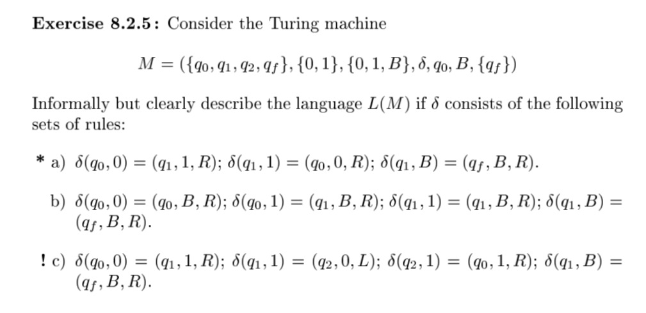
Class Activity

Slide 16
References
Book Chapter
Lectures from Stanford University
http://infolab.stanford.edu/~ullman/ialc/spr10/spr10.html#LECTURE%20NOTES
Lectures from Washington State University
http://www.eecs.wsu.edu/~ananth/CptS317/Lectures/

